Slide 1

First Presentation of Project on
“SMART WHEELCHAIR AND HOME AUTOMATION FOR PARALYZED”
Presented by
24. JASIRA T P
34. NAYANA RAMESHAN
46. SHRAVAN SREEDEEP
48. SOORYA P
under the guidance of
Dr. C SREEKUMAR
DEPARTMENT OF ELECTRICAL & ELECTRONICS ENGINEERING
GOVT. COLLEGE OF ENGINEERING KANNUR- 670563
Oct 2021

Slide 2
Overview
Introduction
Objectives
Literature Review
Basic Block Diagram
Smart Wheelchair
Work Done
Work Plan
Conclusion
Reference

Slide 3
INTRODUCTION
Paralyzed stroke patients are unable to normally communicate with their environment. For these patients, the only part of their body that is under their control, in terms of muscular movement, is their eyeballs.
The biggest problem that paralyzed patients face is leading their own life without anyone else's help. This includes basic day to day operations like switching on basic devices like fan, bulb etc.

Slide 4
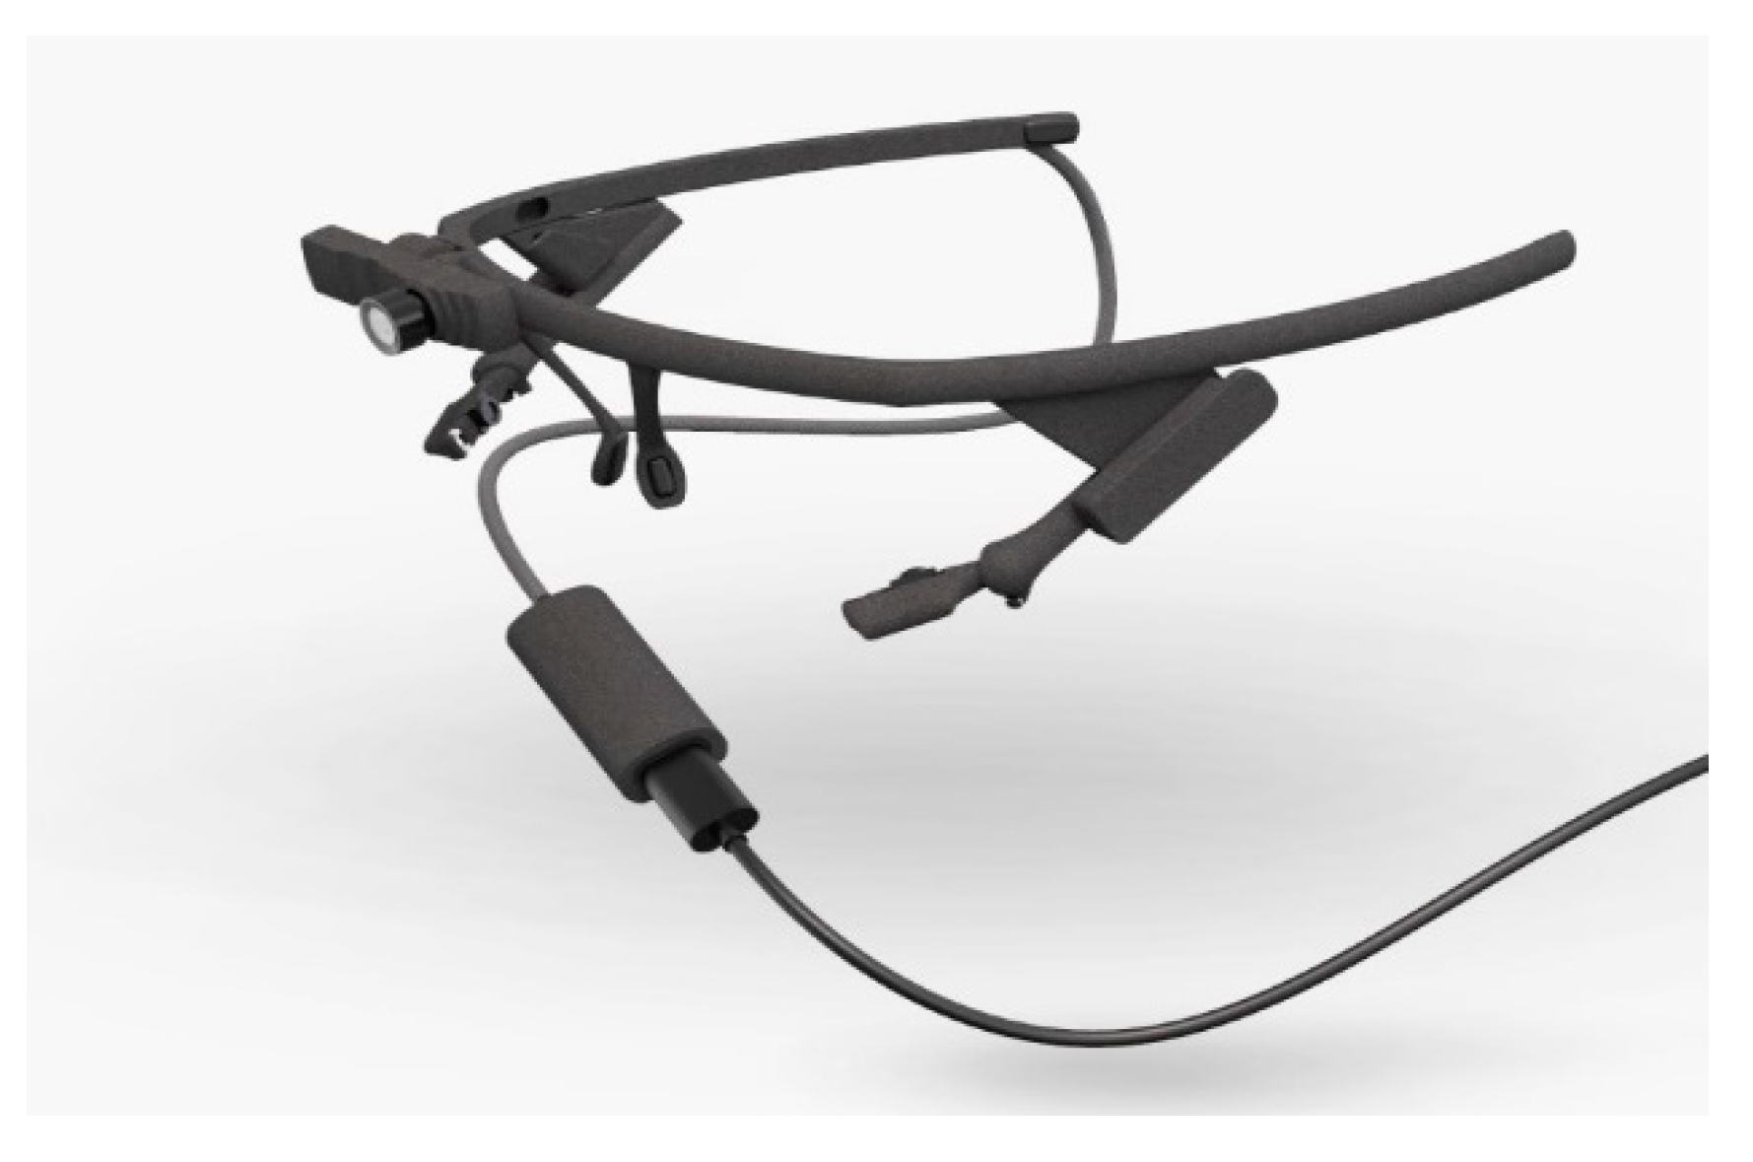
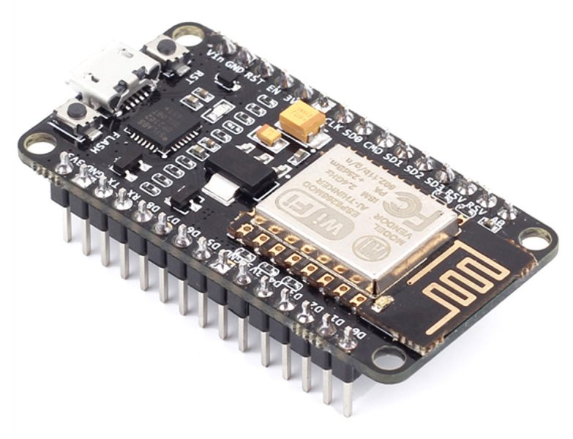
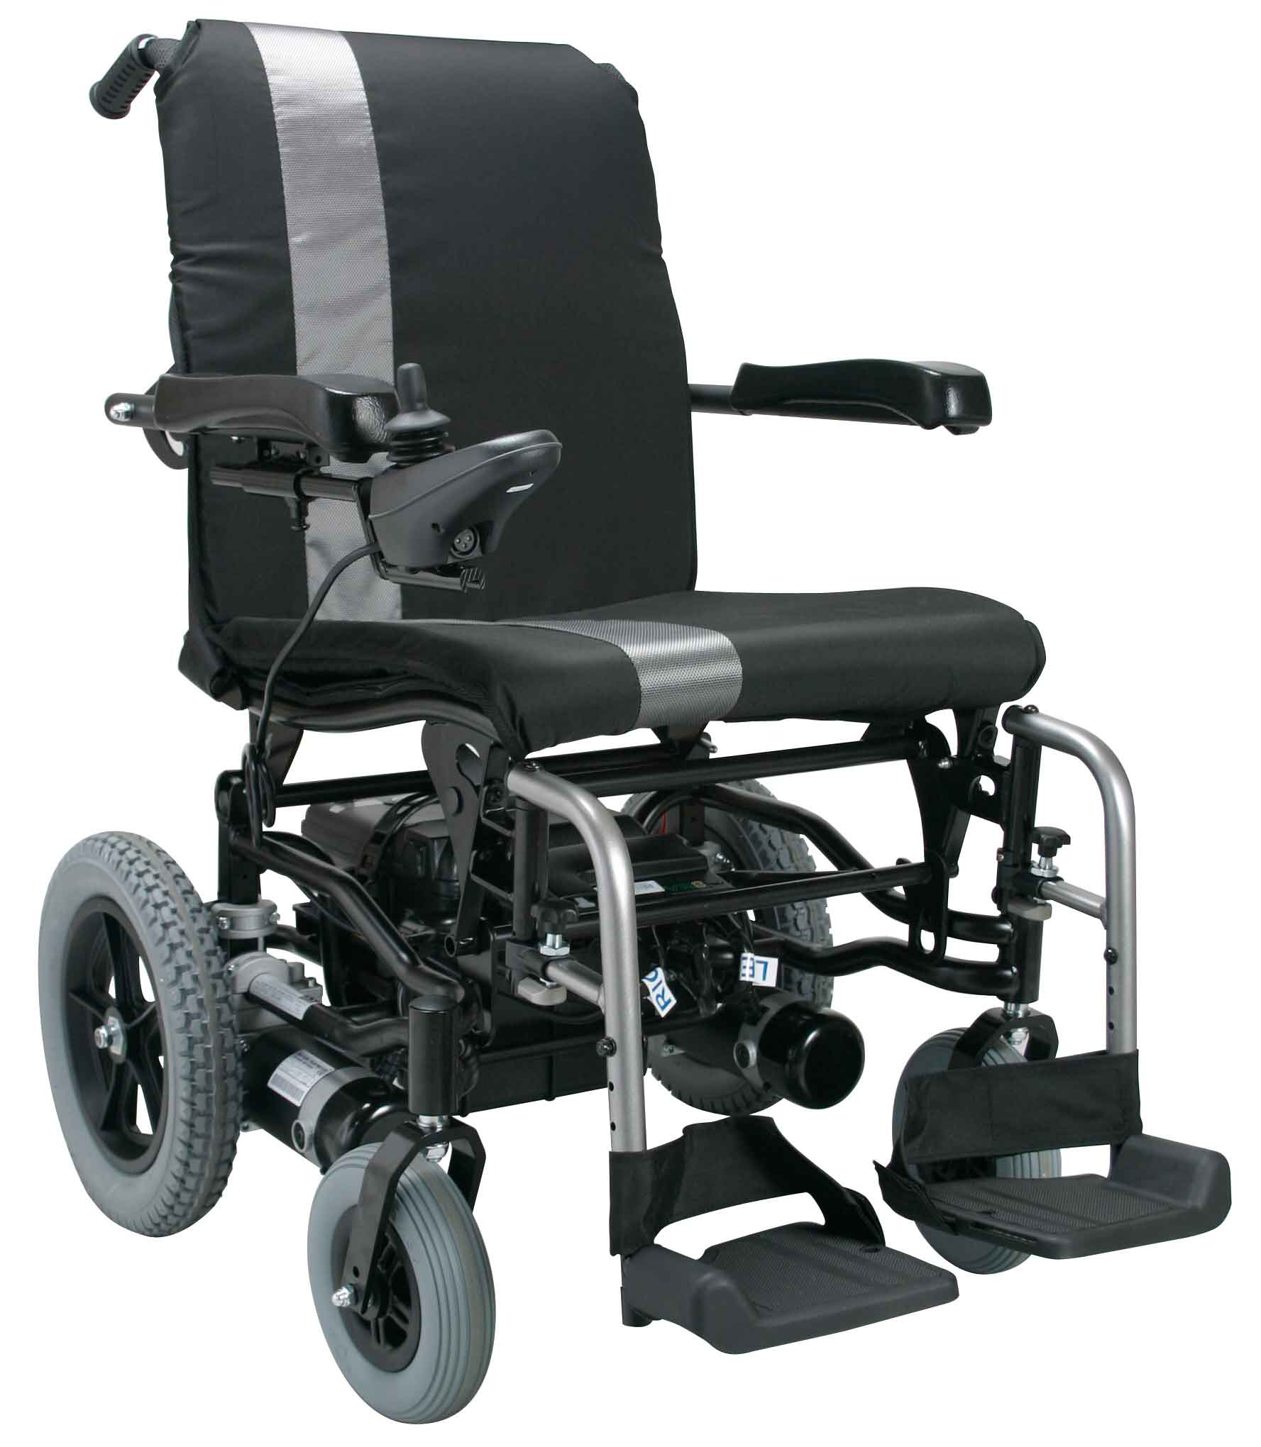
OBJECTIVES
To track eye movement and control basic devices like bulb, fan etc.
To design and implement an autonomous electric wheelchair.
To control the electric wheel chair by tracking eye movements.

Slide 5
LITERATURE REVEIW
Joseph K George, Subhin K B, Arun Jose,Hima T, “Eye Controlled Home-Automation For Disables”, IOSR, 2019
A low cost eye movement based detection device for controlling home appliances has been discussed in this paper. The device is based on the acquisition of eye blinks which is comparatively inexpensive, efficient in terms of linear relationship of the signal over the eye movements that makes it suitable for the application. The device here incorporates activation and deactivation of appliances such as fan, bulb, GSM and alarm etc. The method of eye tracking using camera requires a fully dedicated system with image processing software during the entire working of the unit.

Slide 6
LITERATURE REVEIW
Tan Kian Hou, Yagasena and Chelladurai, “Arduino based voice controlled wheelchair”, ICE4CT, 2019
This paper describes the design of a smart, motorized, voice controlled wheelchair using embedded system. Proposed design supports voice activation system for physically differently abled persons incorporating manual operation. This paper represents the “Voice-controlled Wheel chair” for the physically differently abled person where the voice command controls the movements of the wheelchair. The voice command is given through a cellular device having Bluetooth and the command is transferred and converted to string by the BT Voice Control for Arduino and is transferred to the Bluetooth Module SR-04connected to the Arduino board for the control of the Wheelchair.

Slide 7
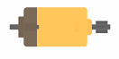
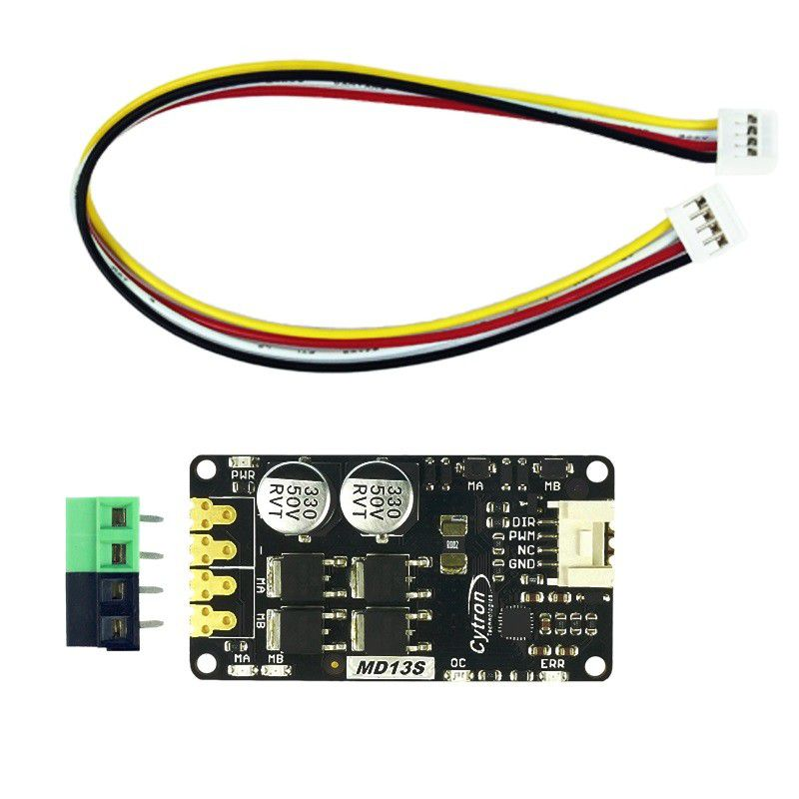
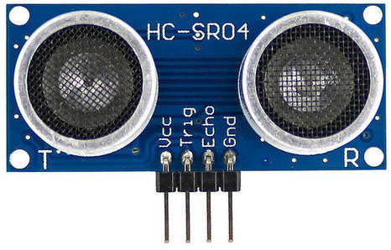
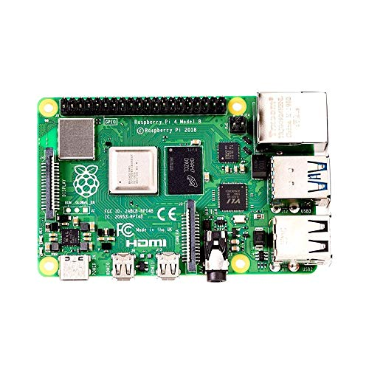
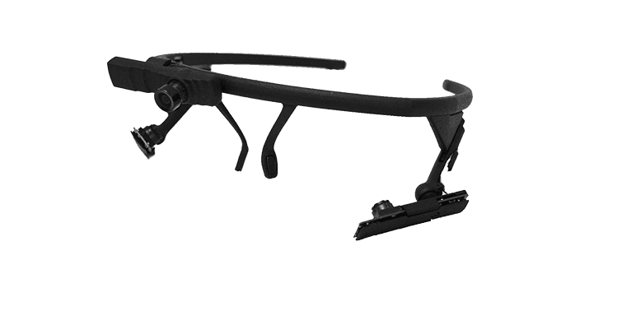
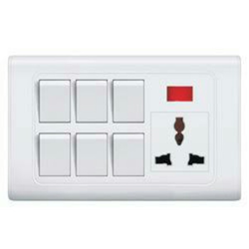
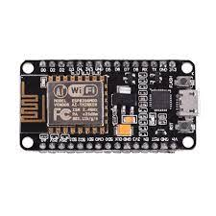
BASIC BLOCK DIAGRAM
×8
LEFT MOTOR
DC MOTOR DRIVER
CAMERA MODULE
RIGHT MOTOR
RASPBERRY PI 4
NODE MCU

Slide 8
SMART WHEELCHAIR
The whole project is divided into 3 parts
Eye tracking module using Raspberry Pi 4
Home automation system using Node MCU and Bluetooth Module
Wheel Chair

Slide 9
SMART WHEELCHAIR
Eye tracking module using Raspberry Pi 4
Camera Module is used to capture eye movements.
The eye movement is tracked using the python eye tracking model using Raspberry Pi 4.
The position of the pupil is transferred to Node MCU using Bluetooth module.

Slide 10
SMART WHEELCHAIR
Wheel Chair
Wheel chair is also controlled on the basics of the control signal received from Raspberry Pi 4.
The wheel chair have low speed for safety.
8 ultra sonic sensors are connected in 4 directions of the wheelchair for obstacle detection.
Incase an obstacle is identified the wheel chair stops and correct trajectory.

Slide 11
SMART WHEELCHAIR
Home automation system using Node MCU and Bluetooth Module
From the position received from Raspberry Pi 4, appropriate decision is taken by the Node MCU.
Control by Node MCU include the switches of light, fan and alarm.

Slide 12
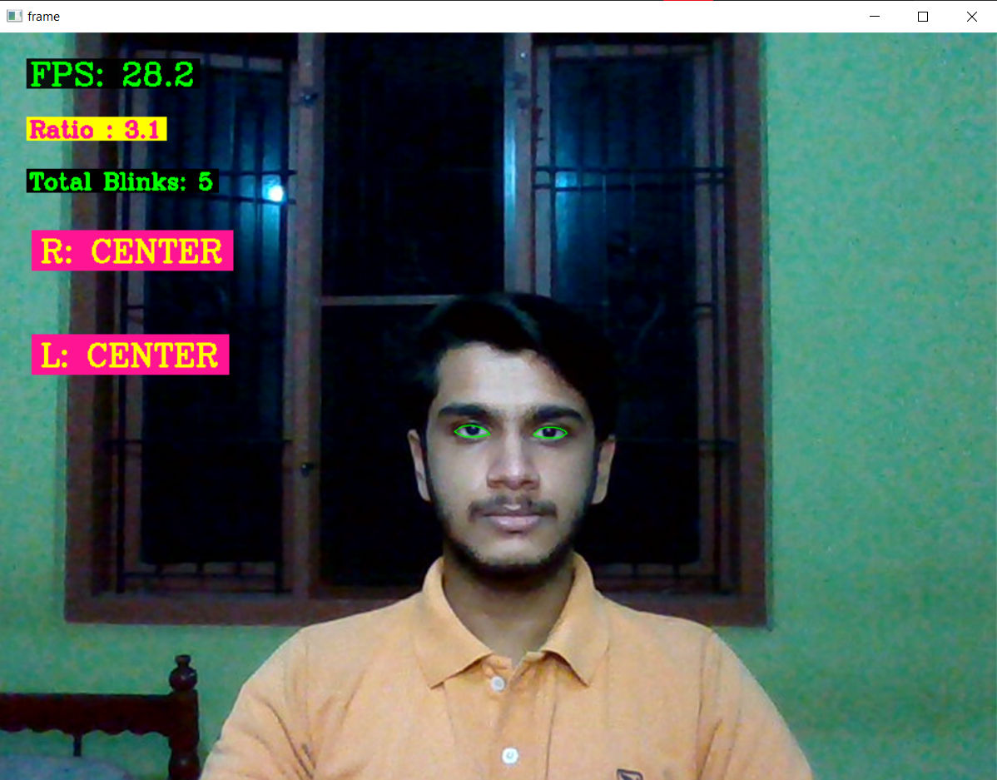
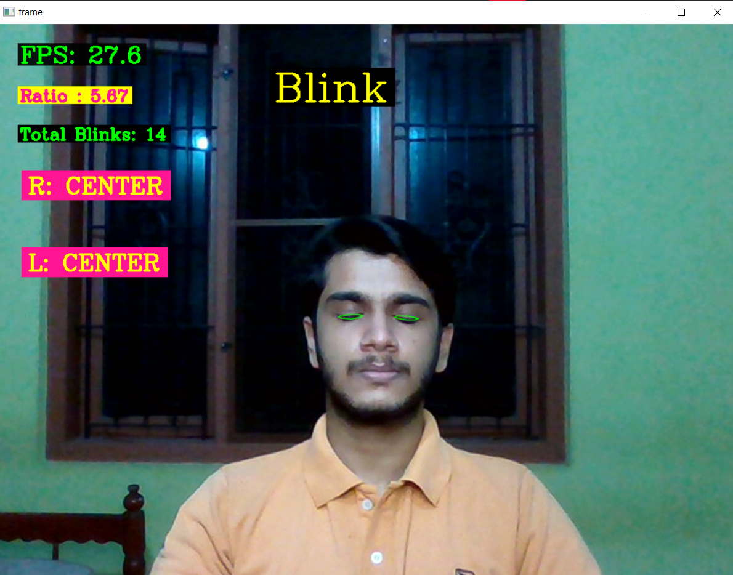
WORK DONE
Eye tracking program is developed and its results are shown below.
Straight
Closed

Slide 13
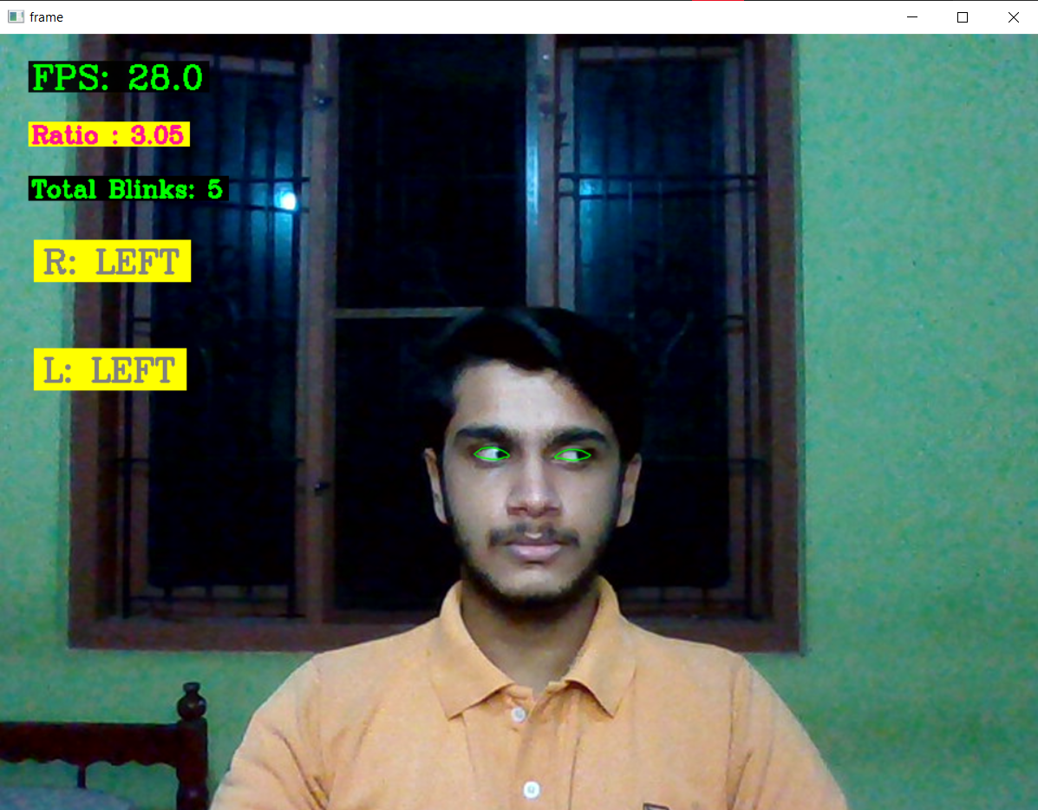
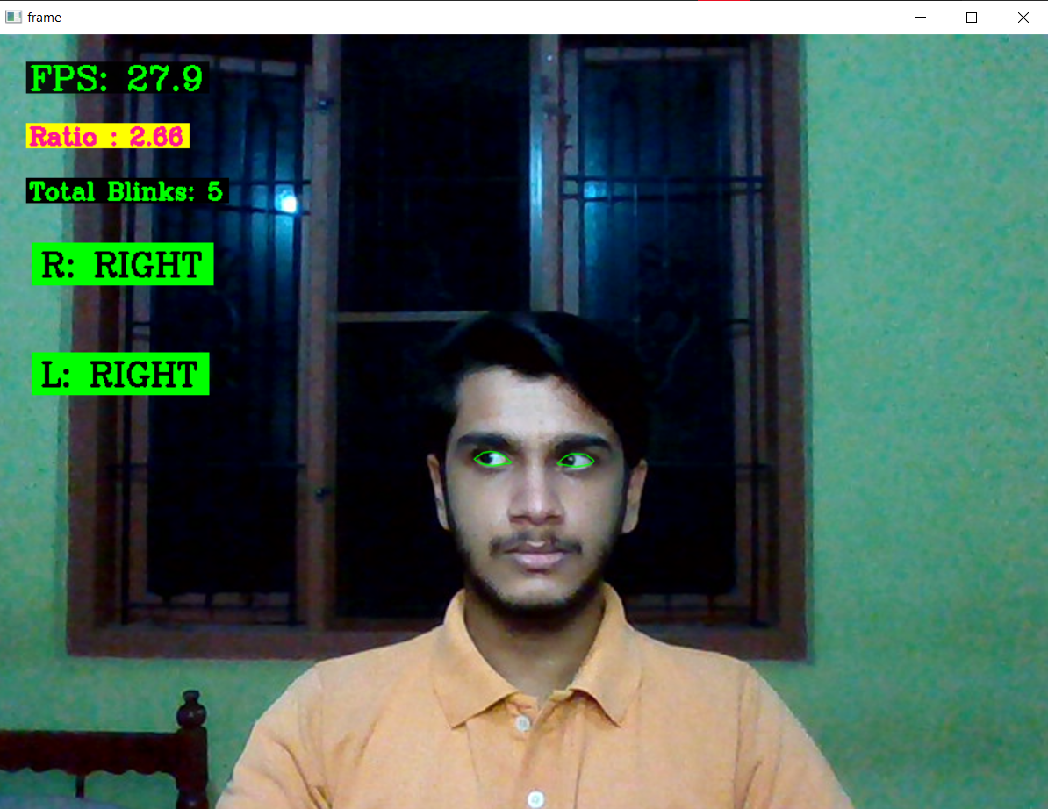
WORK DONE
Eye tracking program is developed and its results are shown below.
Left
Right

Slide 14
WORK PLAN
Program and train machine learning model for eye tracking. (7th semester)
Design and implementation of small model of autonomous wheelchair. (7th semester)
Design and implementation of the circuit for home automation. (7th semester)
Interface the eye tracker, home automation and wheelchair together. (7th semester)
Fabrication of home automation system. (8th semester)
Hardware implementation of eye tracking glasses. (8th semester)
Test and solve real time issues. (8th semester)
Hardware implementation of autonomous wheel chair. (8th semester)

Slide 15
CONCLUSION
Literature review for the proposed model are done.
After discussion and consultation, Raspberry Pi 4 is selected as the main controller.
Eye tracking model is developed.
Started working on small model of autonomous wheel chair.

Slide 16
REFERENCE
[1]Ahmad F. Klaib1, Nawaf O. Alsrehin1, Wasen Y. Melhem2, Haneen O. Bashtawi2, Aws A. Magableh1. “Eye Tracking Algorithms, Techniques, Tools, and Applications with an Emphasis on Machine Learning and Internet of Things Technologies”, September 2020
[2]Pramodini A. Punde, Dr. Mukti E. Jadhav, Dr. Ramesh R. Manza, “A study of Eye Tracking Technology and its applications”, 2017 IEEE
[3]Tan Kian Hou, Yagasena and Chelladurai“Arduino based voice controlled wheelchair”, 2020
[4]Joseph K George, Subhin K B, Arun Jose,Hima T, “Eye Controlled Home-Automation For Disables”, IOSR, 2019
[5] Deepak Kumar, Reetu Malhotra, S. R. Sharma, “Design and Construction of a Smart Wheelchair”, WEEF, 2019

Slide 17
THANK YOU

